Slide 1
Music Genre Classification
SHAI Team Project
Group1 Team 2 - Ammar Alhasanat
الحارث بشار الحاج حسين فهد صلاح شديد الشيماء محمد المذيب أحمد علي فتحي الشيخ أحمد

Slide 2
Agenda
Final Results
Model Selection
Data Preprocessing
6
4
Model Fine-tuning
EDA
2
Features Engineering
5
1
3

Slide 3
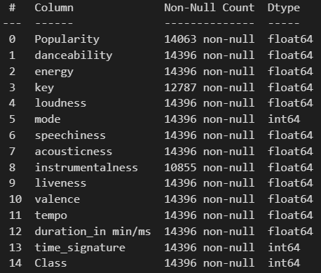
EDA
The Data consists of 14396 rows, and 15 columns.
Target variable: ‘Class’

Slide 4
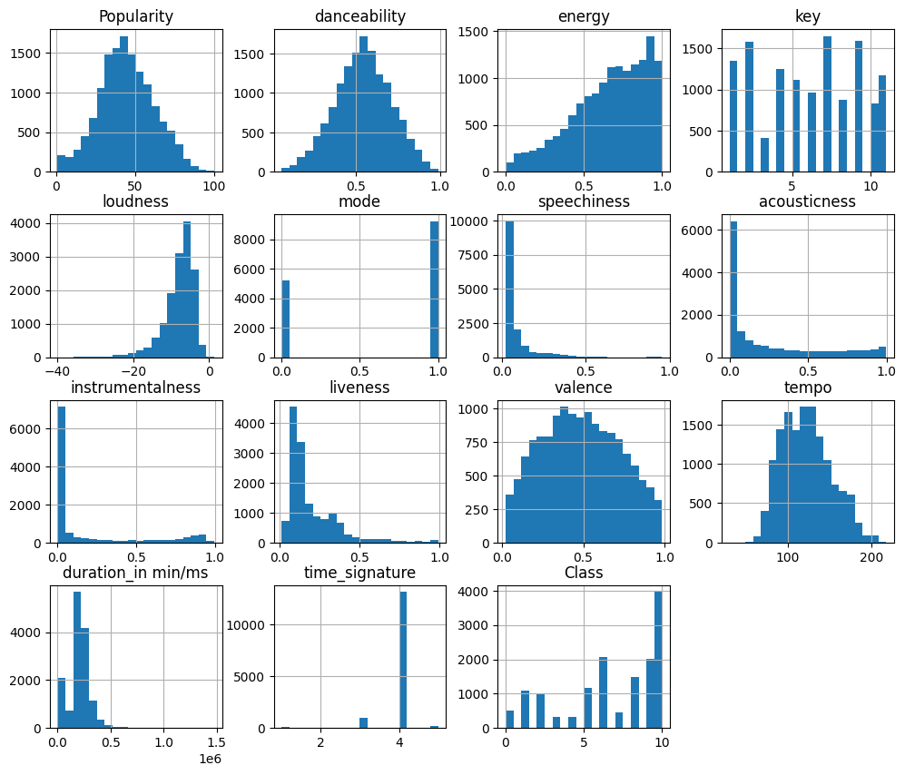
EDA
Upon first inspection of the distribution of features we find the following:
popularity, danceability, valence, and tempo are distributed naturally.
Skewed distributions were found in other features. Ex: loudness is skewed to the left.
This indicates that we have to use techniques such as normalization and transformation to better represent the data.

Slide 5
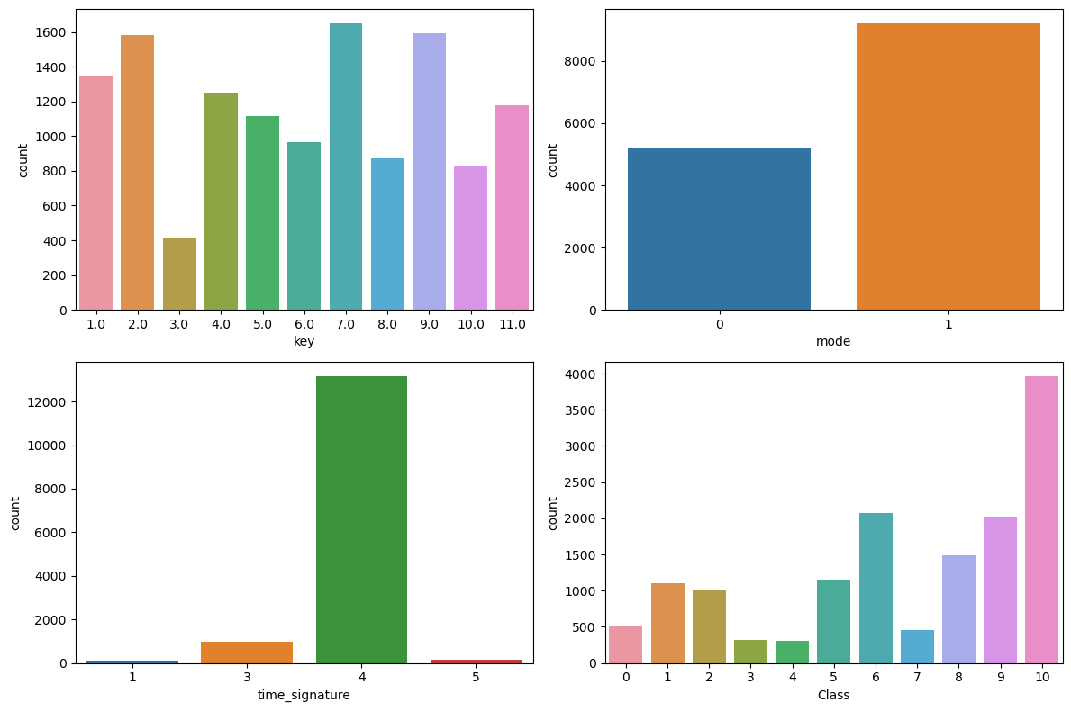
EDA
Bar Plots:
We visualize the count of categorical features.
Interestingly, a time signature of 4 is the most repeated time signature. This can be case of class imbalance.

Slide 6
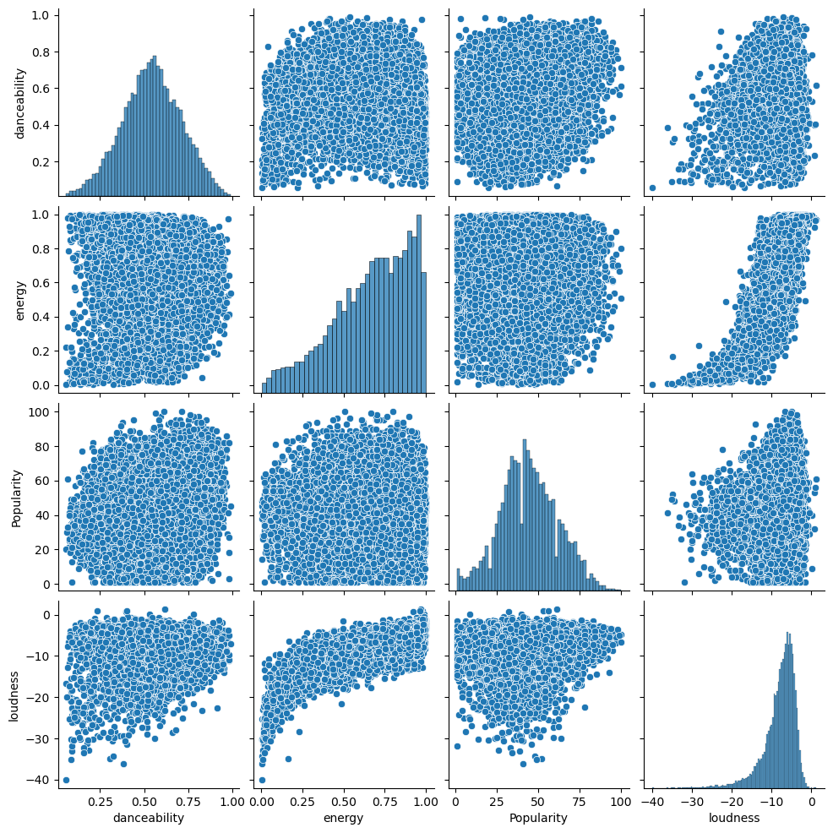
EDA
Scatter Plots:
Showing a matrix of relationships between numerical variables.
We observe an interesting relationship between loudness and energy for example.

Slide 7
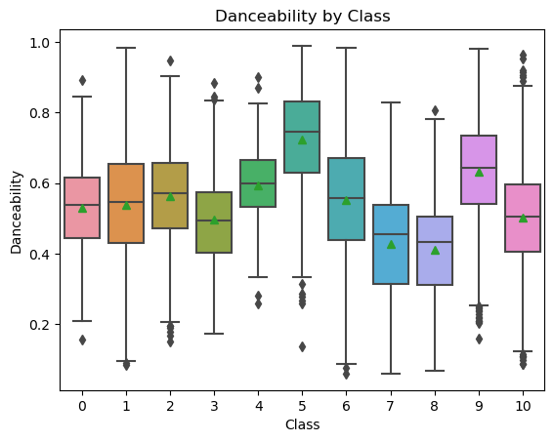
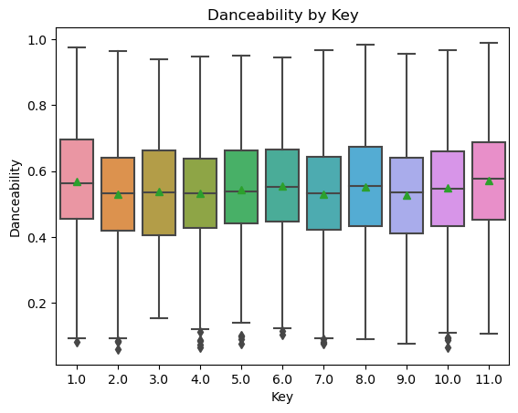
EDA
Box Plots:
Box plots for categorical features.

Slide 8
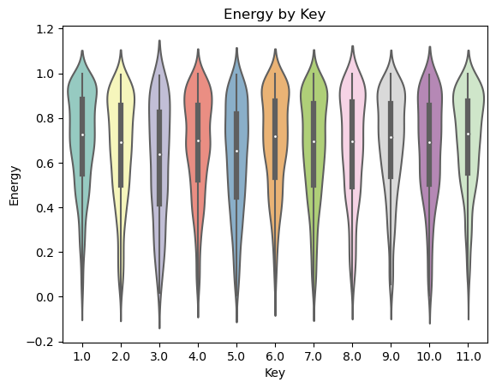
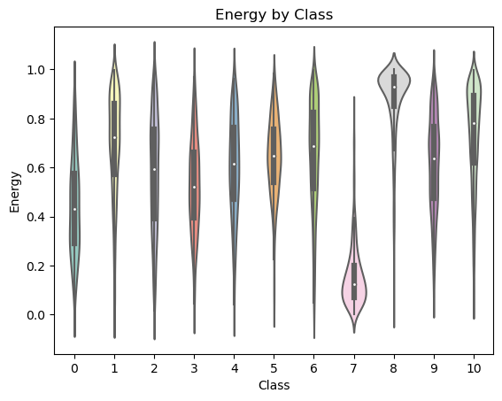
EDA

Slide 9
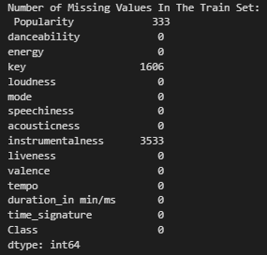
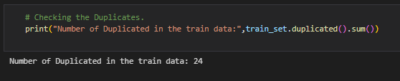
EDA
Other Observations:

Slide 10
Data Preprocessing
01
Handle Null, Zero and Duplicate Values
02
Custom Label Encoding
03
Logarithmic and power transformations to numerical columns and cap outliers
04 Scaling the data using the StandardScaler

Slide 11
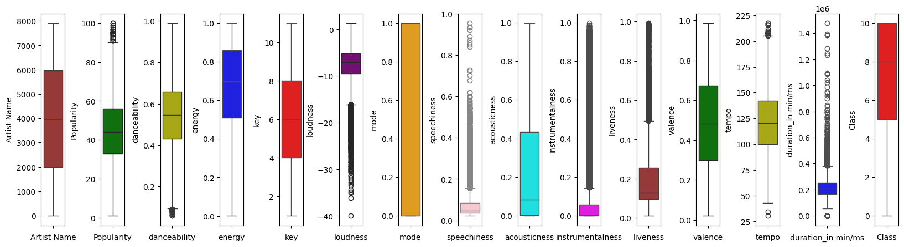
Data Preprocessing
Identifying Outliers using box plots
outliers in popularity with significantly higher popularity.
As well as in loudness, specchiness, temp, and duration in min/ms

Slide 12
Data Preprocessing
More about outliers handling…..
For the outliers First, we convert all the values to its log value as the log transform one of the best ways to fix the outliers in the data
Outliers
Then we use the IQR to handle the remaining outliers, because the IQR is a robust, effective, simple, and non-parametric method for identifying and handling outliers.

Slide 13
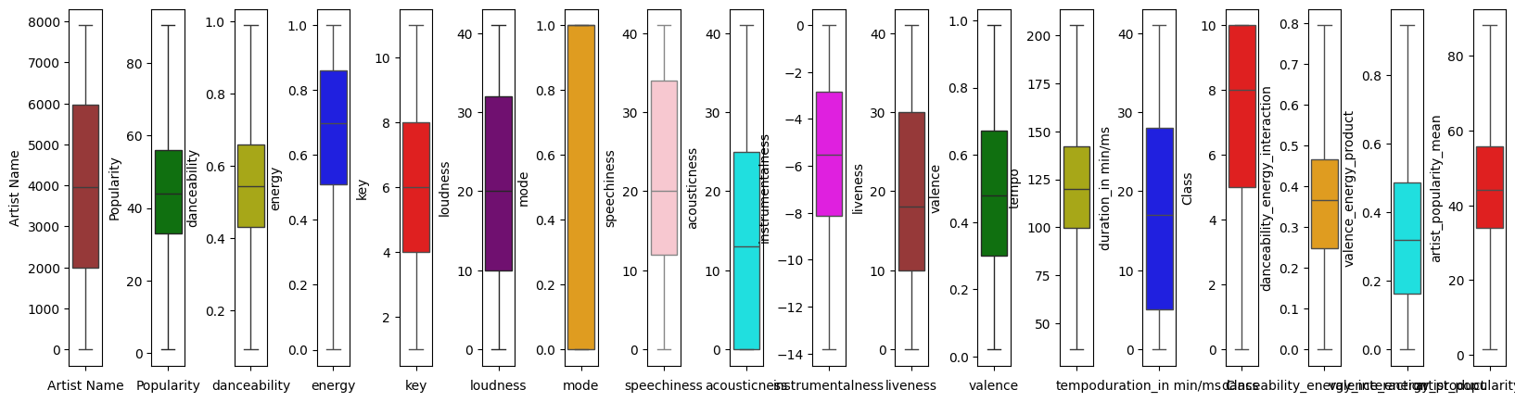
Data Preprocessing
The Data after cleaning from Outliers :

Slide 14
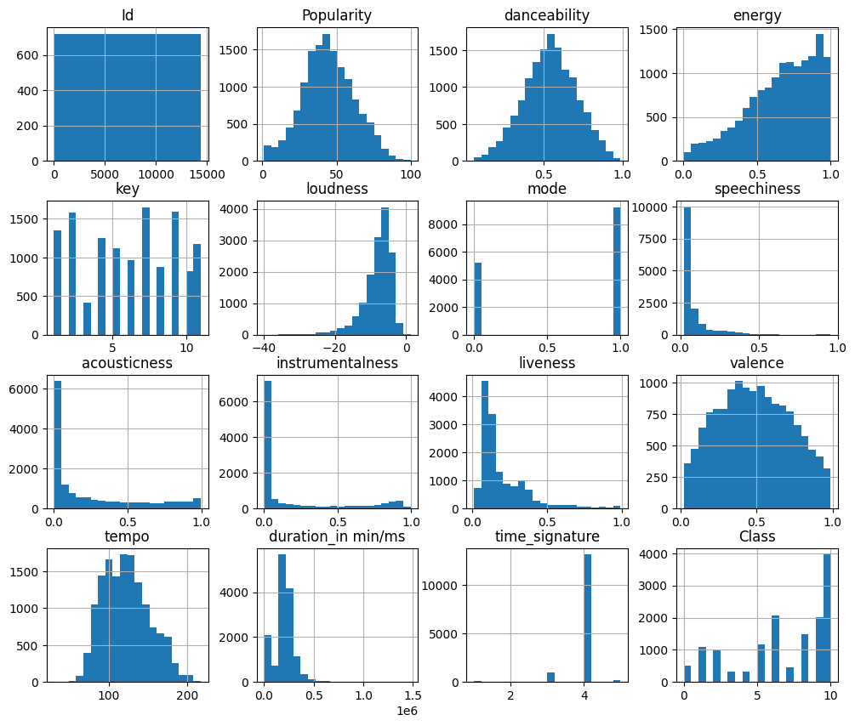
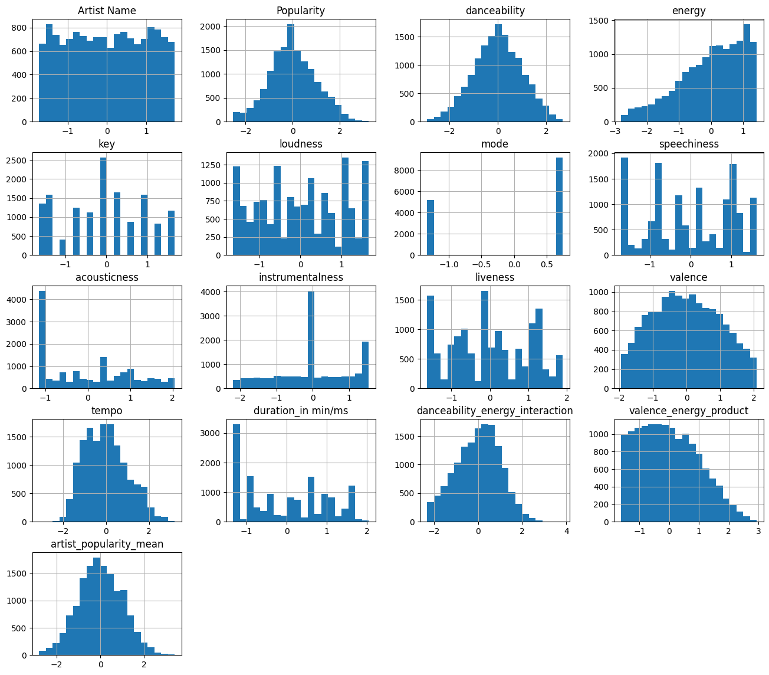
Data Preprocessing
The processed data for training the model:
Before
After

Slide 15
Features Engineering
Interactions:
Aggregations:
Danceability_energy_interaction = Danceability*Energy
Indicating songs that are both highly danceable and energetic
Valence_energy_product = valence * energy
Indicating songs that are both positive and energetic.
We create a series that has the artist name and their average popularity. Then by mapping the artist name we create a new column that has the average popularity for each artist.

Slide 16
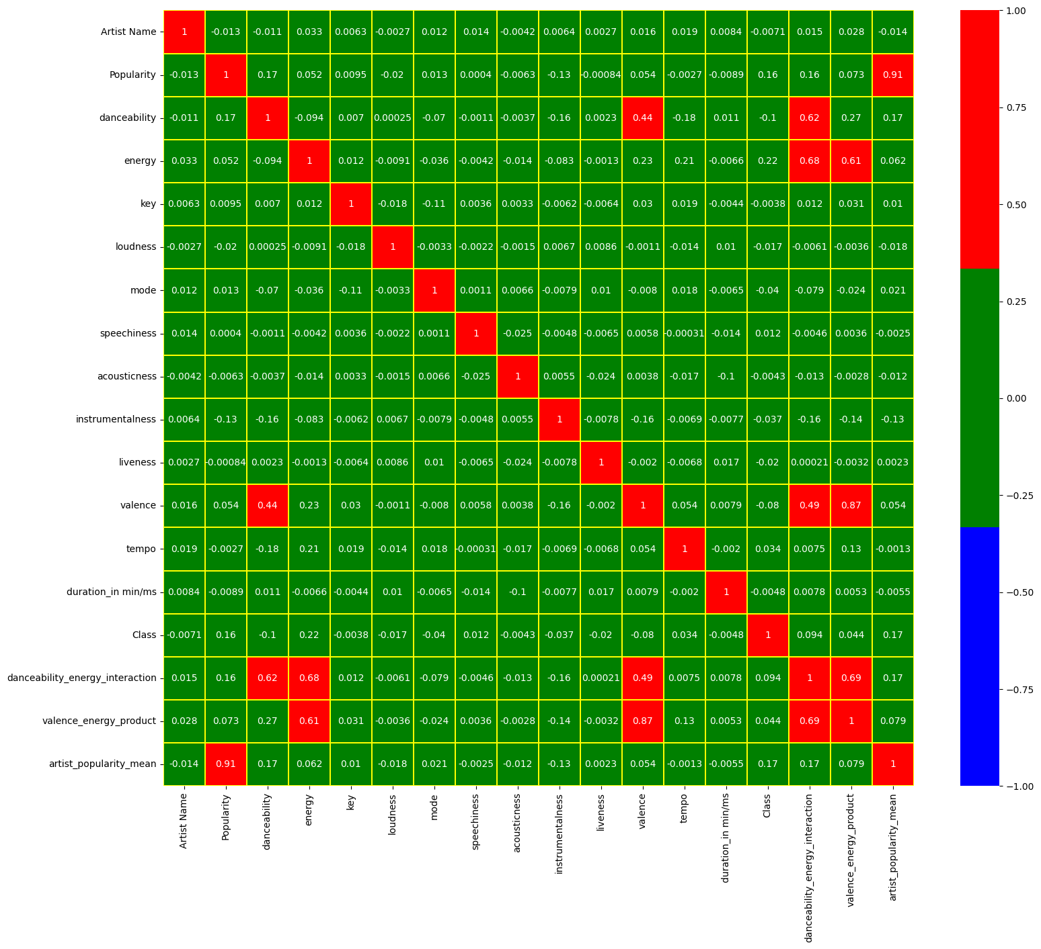

Slide 17
Features Engineering
Highlights from correlation matrix
Acousticness and Energy:
Correlation: -0.7463
Explanation: This is a strong negative correlation, suggesting that tracks with higher acousticness (more acoustic) tend to have lower energy levels. Acoustic tracks might be softer or calmer, which aligns with a lower energy score.
Energy and Loudness:
Correlation: 0.7749
Explanation: This is a strong positive correlation, indicating that tracks with higher energy tend to be louder. This makes intuitive sense since energetic tracks often have higher volume levels.
Class (Target Variable) Correlations:
Energy: 0.2158: Tracks with higher energy tend to belong to specific classes.
Loudness: 0.1941: Louder tracks are slightly more likely to belong to certain classes.
Duration in min/ms: 0.2171: Tracks with longer durations are correlated with specific classes.
Acousticness: -0.2407: Tracks with higher acousticness are less likely to belong to certain classes

Slide 18
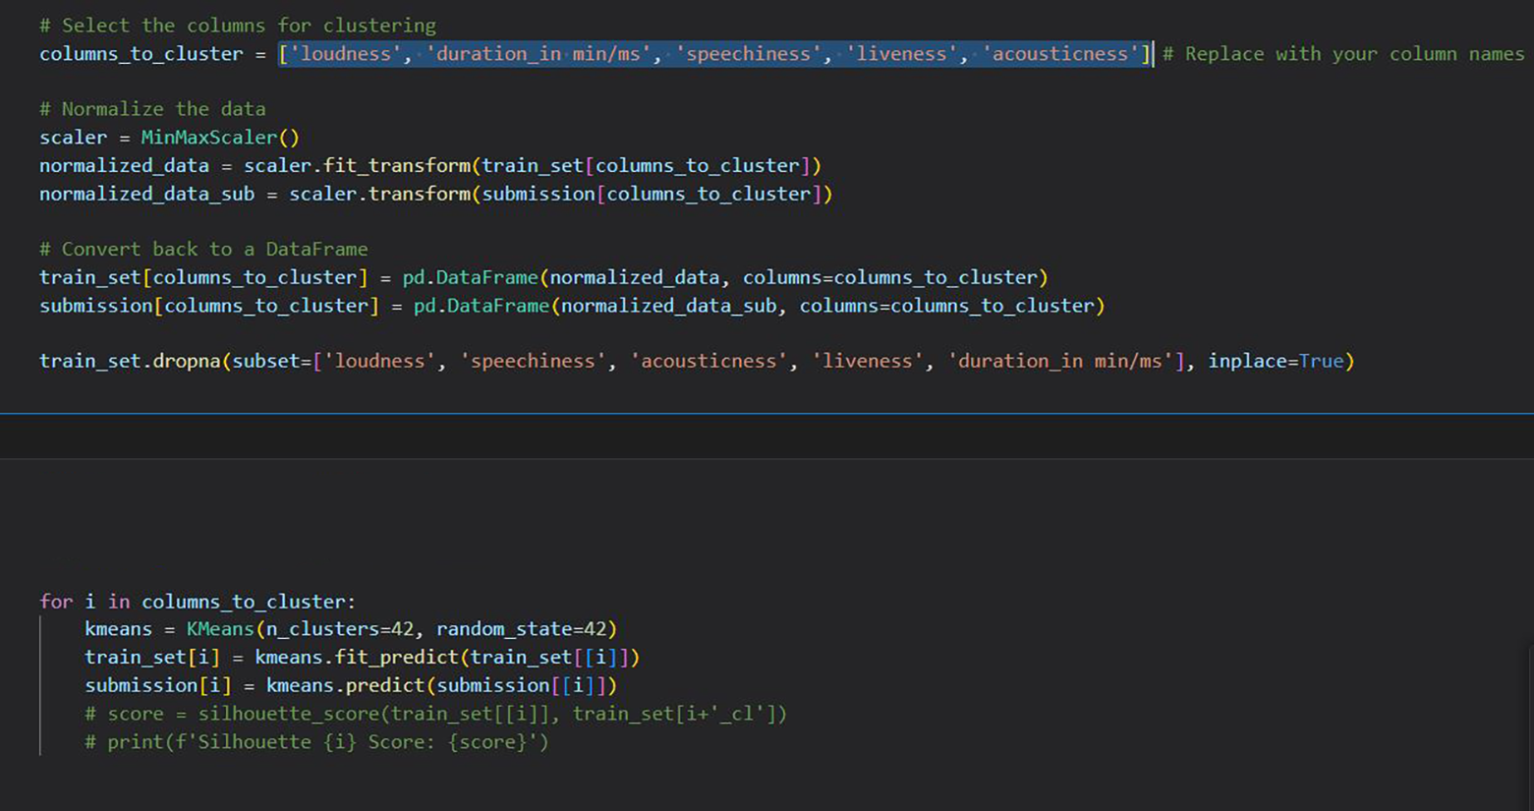
Features Engineering
Clustering
We use K-Means clustering algorithm to transform continuous numerical features into categorical features.
The main benefits of this process:
Capturing Non-Linear Relationships
Handling Outliers
Improved Model Performance

Slide 19
Model Selection Using Ensemble Learning Techniques
Application of Voting and Stacking Classifiers
Implementation of Soft Voting Classifier
Base Models Used:
RandomForestClassifier: High interpretability and robustness.
XGBClassifier: Known for strong performance on structured/tabular data.
LogisticRegression: Simplicity and effectiveness, especially with linear data.
KNeighborsClassifier: Non-parametric method, useful for smaller datasets.
SVC (Support Vector Classifier): Effective for high-dimensional spaces.
Results:
F1 Score (Macro): 0.4835

Slide 20
Model Selection Using Ensemble Learning Techniques
Implementation of Stacking Classifier
Base Models Used: Same as the Voting Classifier (RandomForest, XGBoost, LogisticRegression, KNeighbors, SVC).
Meta-Learner:
RandomForestClassifier : Chosen as the Meta-Learner due to its ability to capture complex patterns by aggregating decisions from the base models.
Results:
F1 Score (Macro): 0.5097
Final Decision:
Based on the results, the Stacking Classifier was selected as the optimal model for the dataset due to its superior performance in F1 Score metrics.

Slide 21
Fine-Tuning of Stacking Classifier
Hyperparameter Optimization Using RandomizedSearchCV
- Objective: Optimize the Stacking Classifier to achieve the best possible performance on the dataset.
- Methodology: Utilized RandomizedSearchCV to explore a wide range of hyperparameters efficiently.
- Evaluation Metric: Focused on F1 Score (Macro) to balance precision and recall across classes.
Defining the Hyperparameter Space
Base Models Hyperparameters:
XGBClassifier: Number of estimators, maximum depth, learning rate, subsample, colsample_bytree, gamma, regularization terms (alpha and lambda), scale_pos_weight.
Meta-Learner Hyperparameters:
RandomForestClassifier: Number of estimators, maximum depth, minimum samples split/leaf, maximum features, bootstrap.
Results:
F1 Score (Macro): 0.5638

Slide 22
Final Results
We make prediction on the test or submission data set using the final model and got this result: 0.57653

Slide 23

T H A N K S F O R W A T C H I N G

